Slide 1
Supply and Demand Analysis – YoY Growth and Peak Performance
Thrift Store Data (2018-2019) with Forecast for 2020

Slide 2
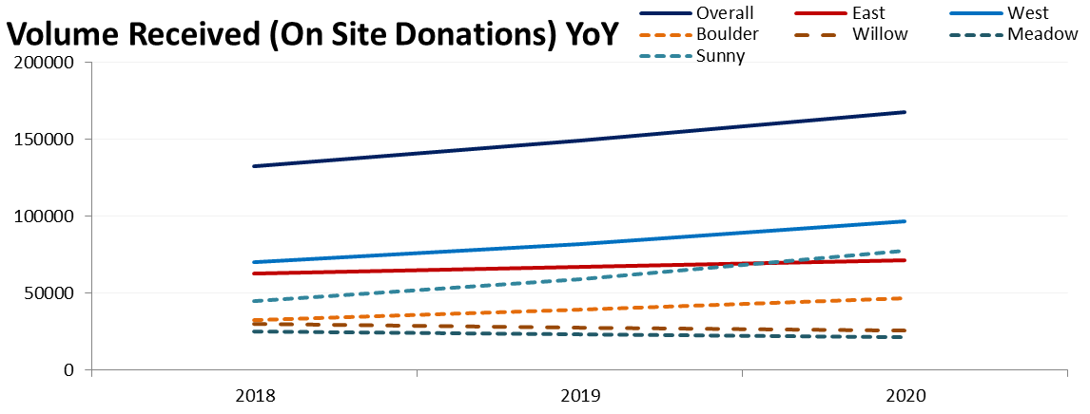
Year-over-Year Growth (Volume Received - On Site Donations)
Overall: 12.42% growth from 2018 to 2019, forecast for 2020 is 168,011 units.
Regional : West Region leads with 17.33% growth, while East has 6.92%.
Stores: Sunny store has strong growth (32.01%), but Willow is declining (-7.40%).
Continue growth efforts in the West Region and address donation decline in Willow Store. Sustain the growth momentum in Sunny Store.

Slide 3
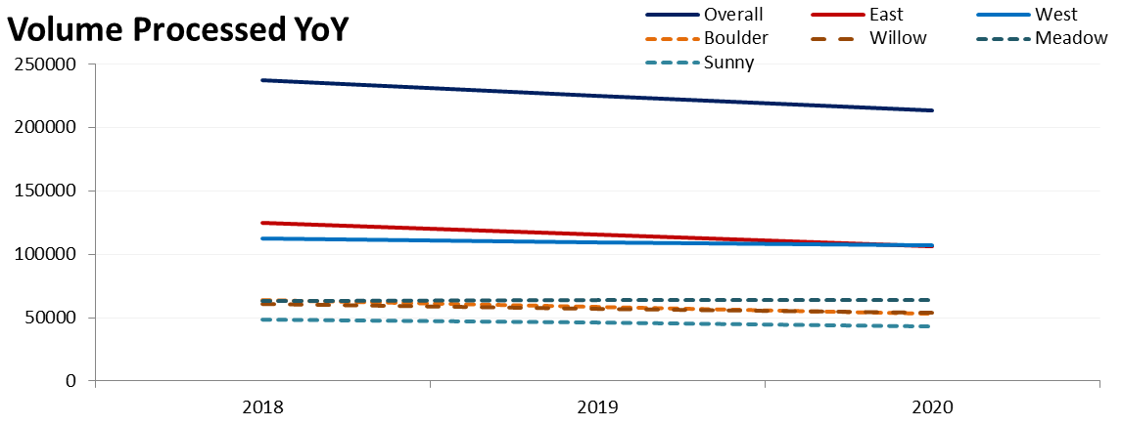
Volume Processed YoY
Overall: Volume Processed declined by 5.08% YoY, further decline forecasted for 2020 (213,884 units).
Regional: East (-7.62%) is declining faster than West (-2.26%).
Stores: Boulder and Willow show significant drops in processing (-9.16% and -6.00%, respectively).
Only Meadow shows a positive forecast, with a slight 0.72% increase predicted for 2020
Resolve operational bottlenecks in the East Region and focus on Boulder and Willow Stores to reverse processing declines

Slide 4
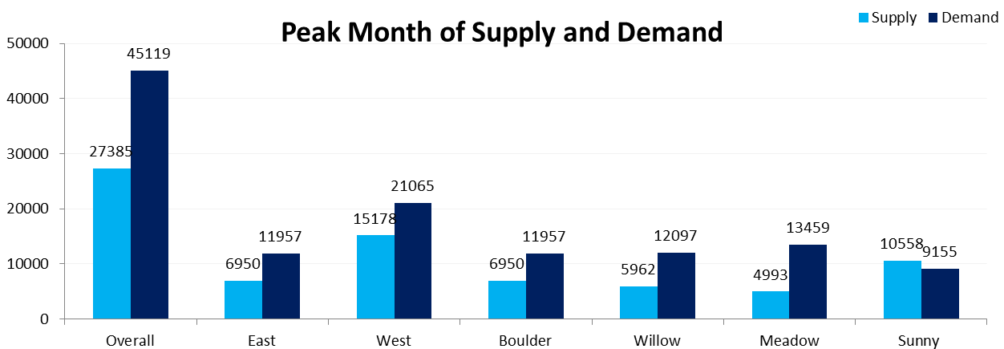
Peak Months for Supply vs. Demand (2018 & 2019 Combined)
Overall: Supply peaked in August (27,385 units), while Demand peaked in October (45,119 units).
Regional: East and West both saw peak supply in August and peak demand in October.
Stores: All stores had peak supply in August and peak demand in October, except for Meadow, which had peak supply, and Sunny, which had peak demand, in March.
Adjust processing schedules to handle peak supply in August and demand in October. Realign workflows in Meadow and Sunny to better balance their unique supply and demand patterns.

Slide 5
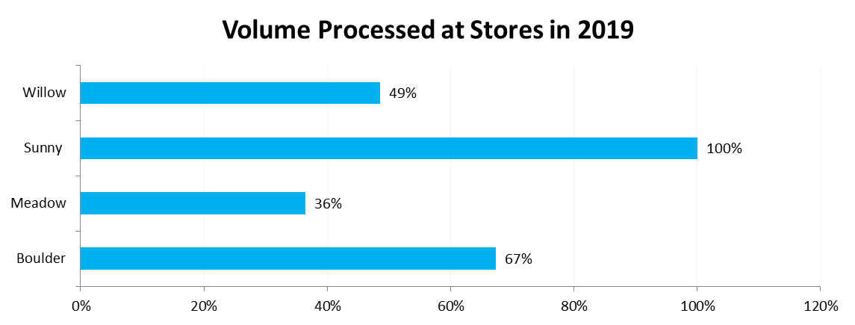
Volume Received vs. Volume Processed (2019 Data)
Overall: 66% of donations were processed in 2019, leaving 34% unprocessed.
Store: Sunny store maxed of its donations, while Meadow processed only 36%.
Focus on improving processing efficiency in Meadow and Willow stores

